Slide 1
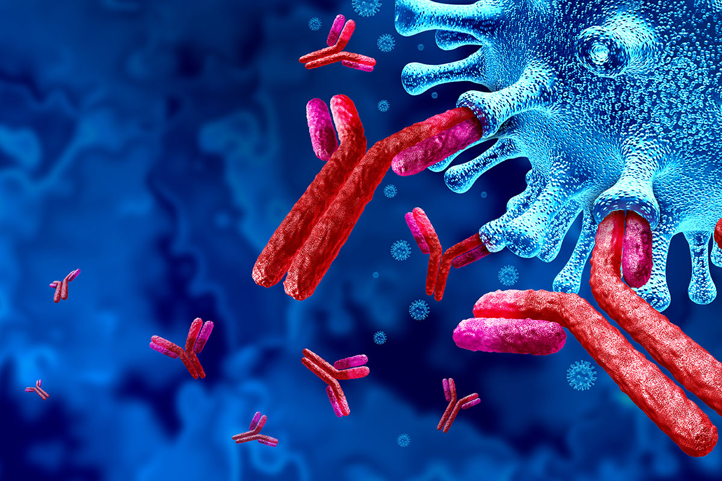
Microscale Modelling of Antibody Dependent Cellular Cytotoxicity
Luke Heirene
Helen Byrne
Eamonn Gaffney
James Yates

Slide 2
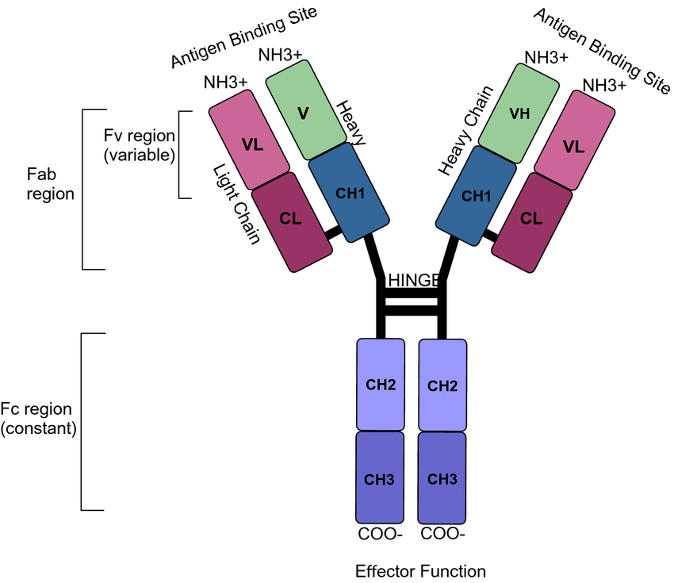
Mark JKK, Lim CSY, Nordin F, Tye GJ. Expression of mammalian proteins for diagnostics and therapeutics: a review. Mol Biol Rep. 2022 Nov;49(11):10593-10608. doi: 10.1007/s11033-022-07651-3. Epub 2022 Jun 8. PMID: 35674877; PMCID: PMC9175168.

Slide 3
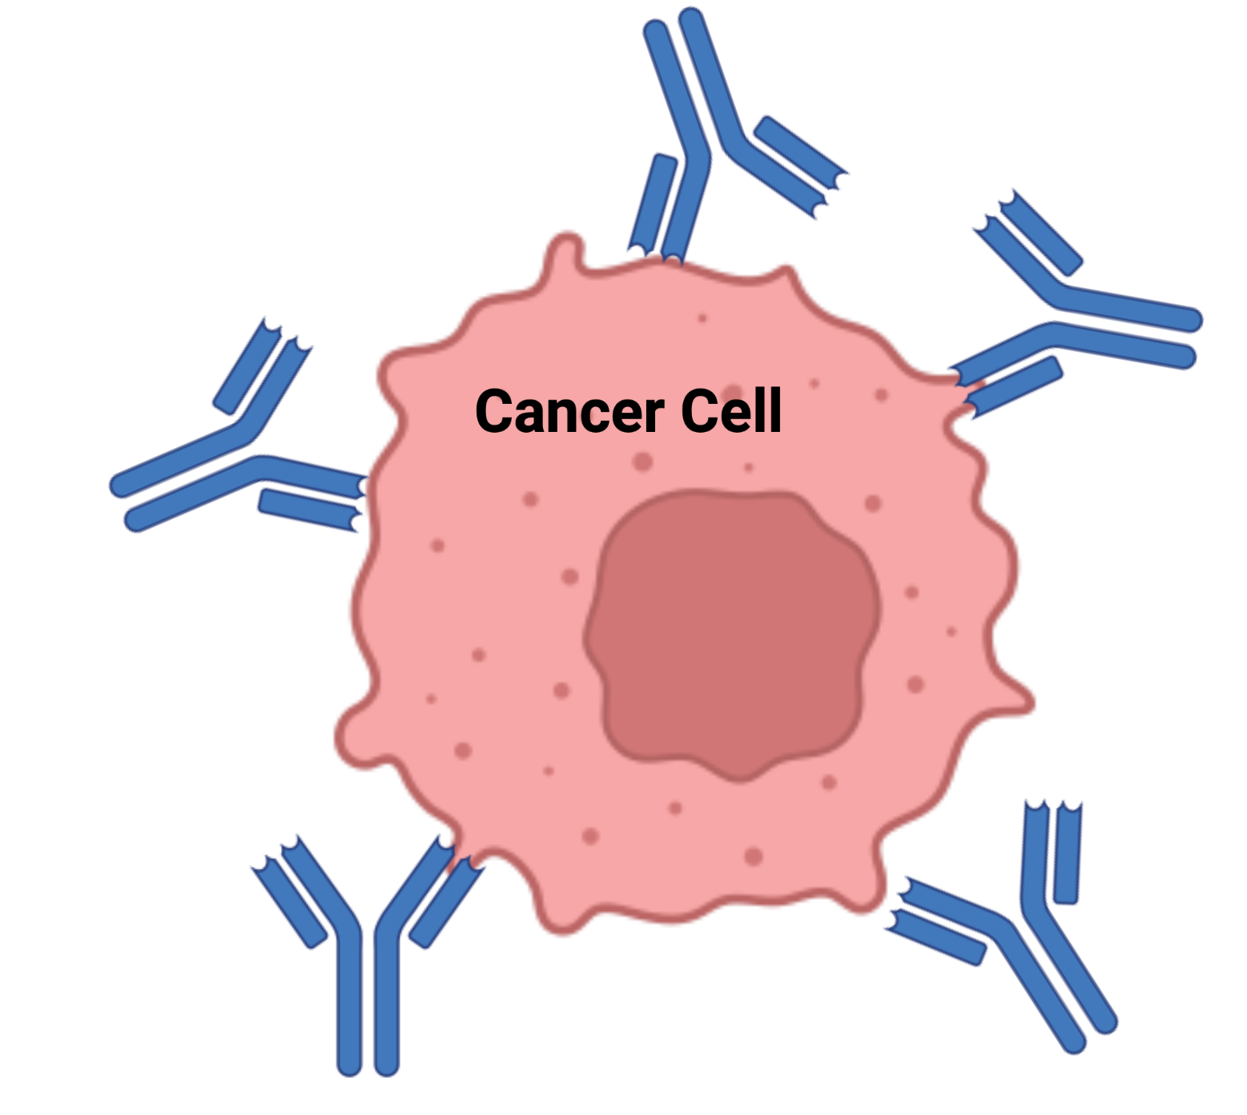
Why Monoclonal Antibodies (mabs)?
Diseases
Cancer
Alzheimer’s disease
Autoimmune diseases
Varieties
Standard mab therapy
Radioimmunotherapy
ADCs
Checkpoint therapy

Slide 4
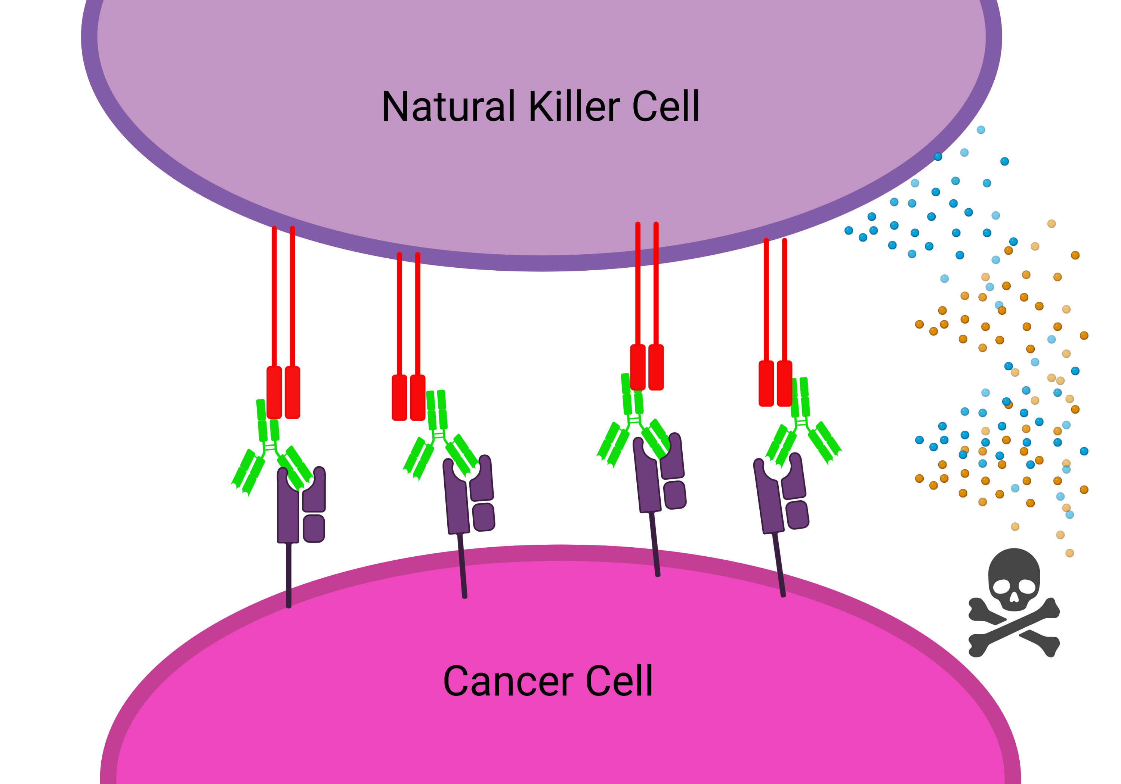
What is ADCC? (Antibody Dependent Cellular Cytotoxicity)
Mabs exert their effects through effector functions
ADCC guides the immune system to attack the tumour

Slide 5
Multiscale Processes affect ADCC
Microscale (receptor level dynamics)
ADCC
Macroscale (cell-cell interactions)

Slide 6
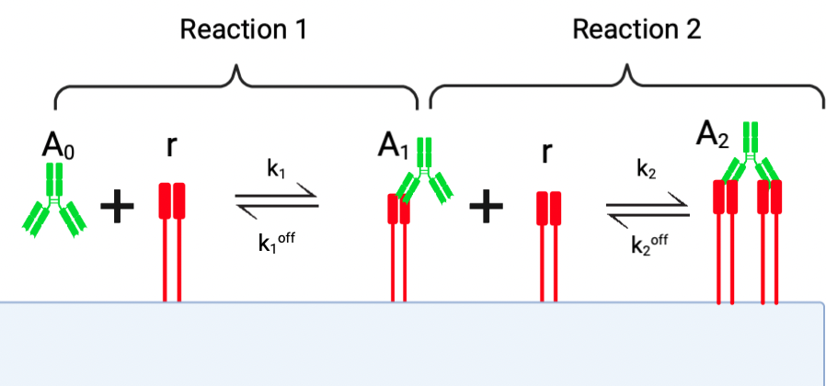

Slide 7
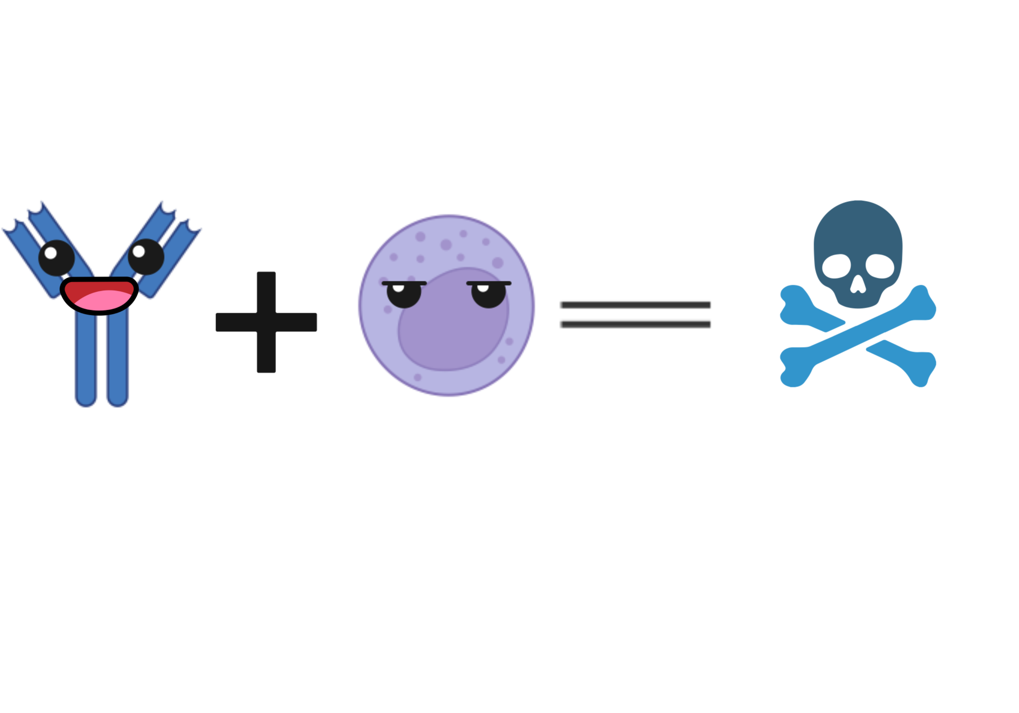

Diffusion-limited Cross-Linking

Slide 8

Cross-linking via a Local Concentration

Slide 9
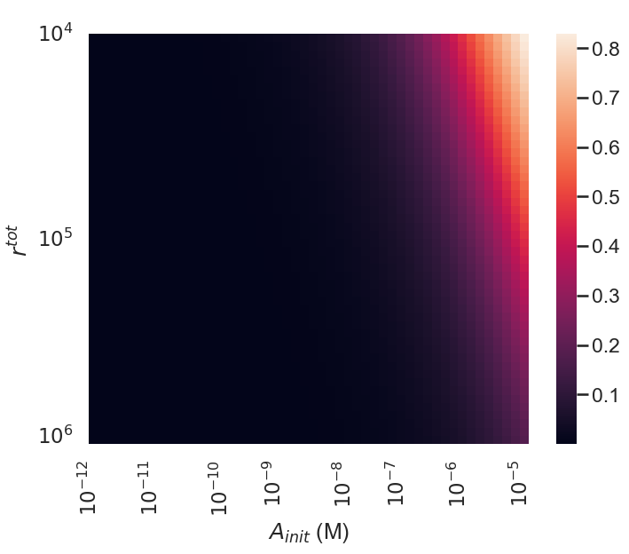

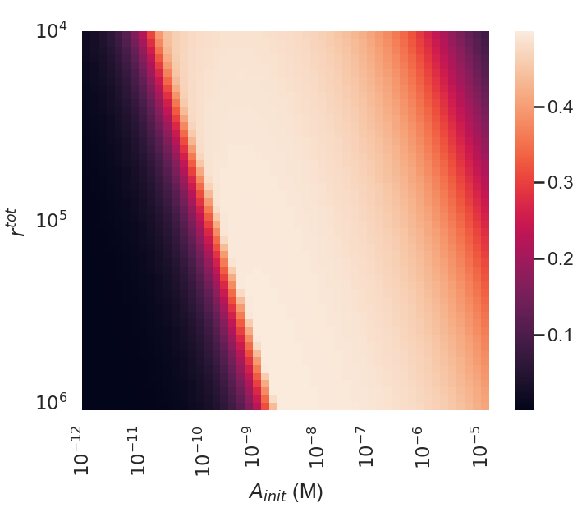
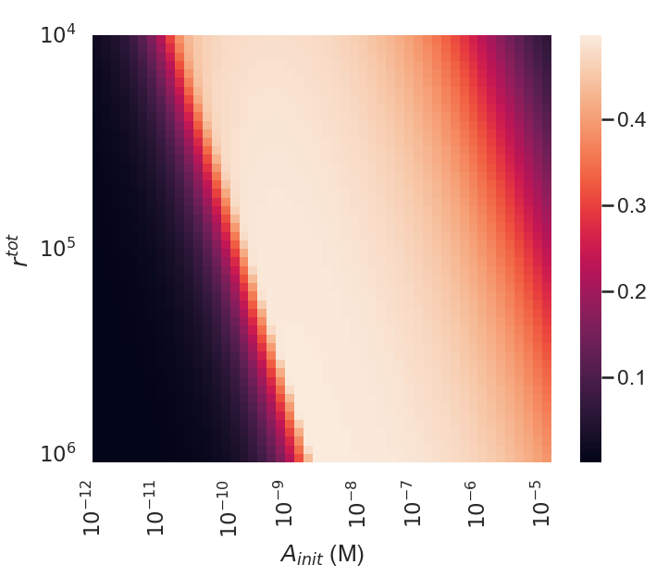
Model S
Model R
A1
Ratio of Antibody to Receptor affects Equilibrium Binding States
A2

Slide 10
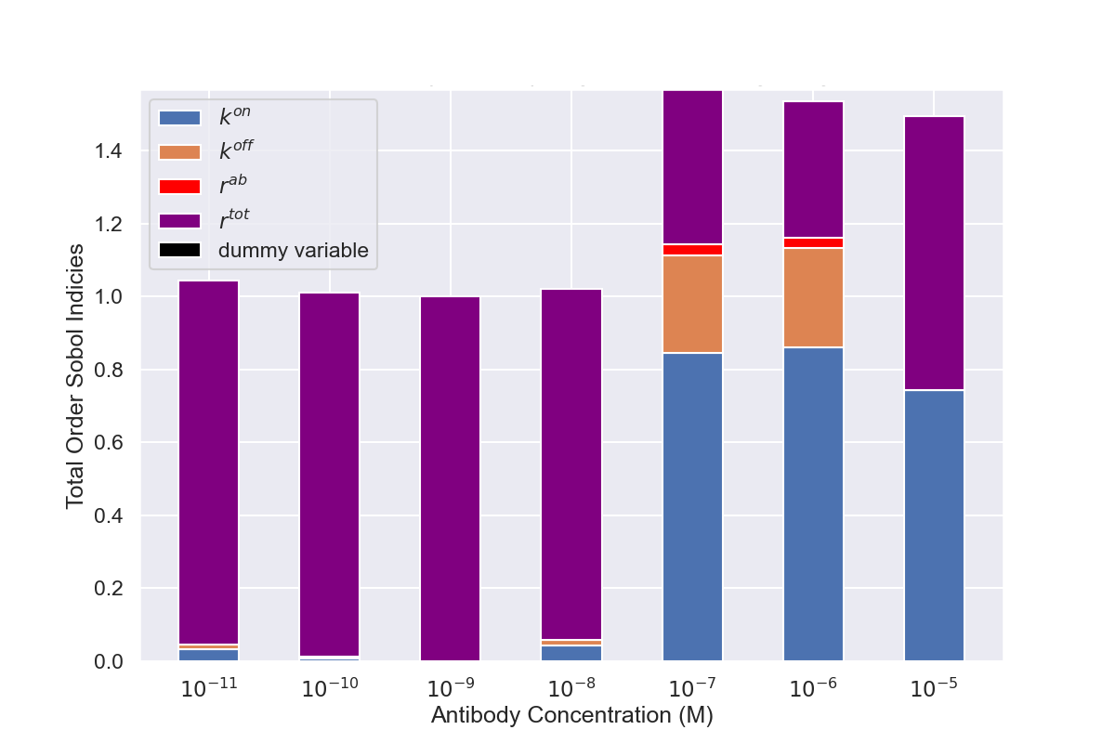
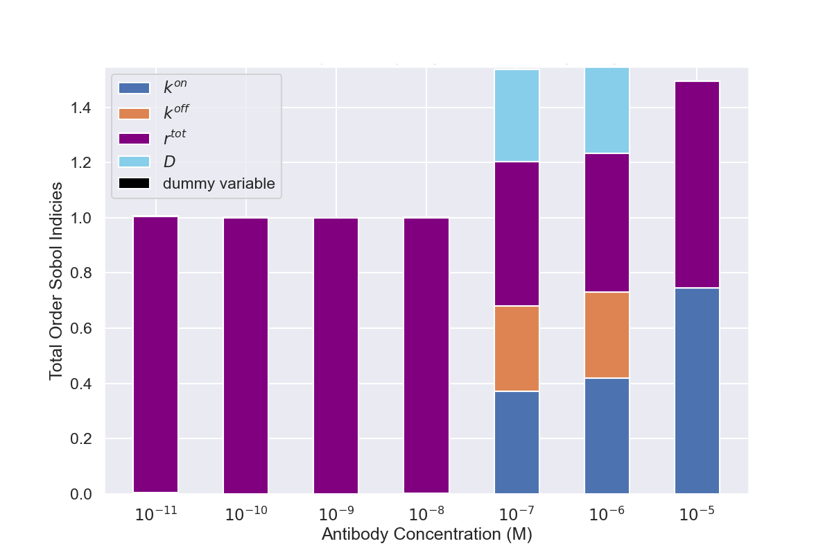
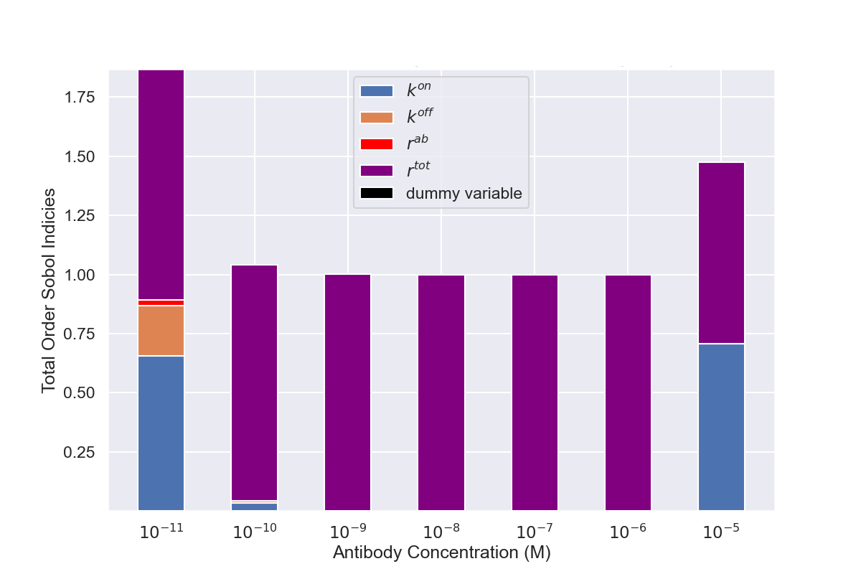
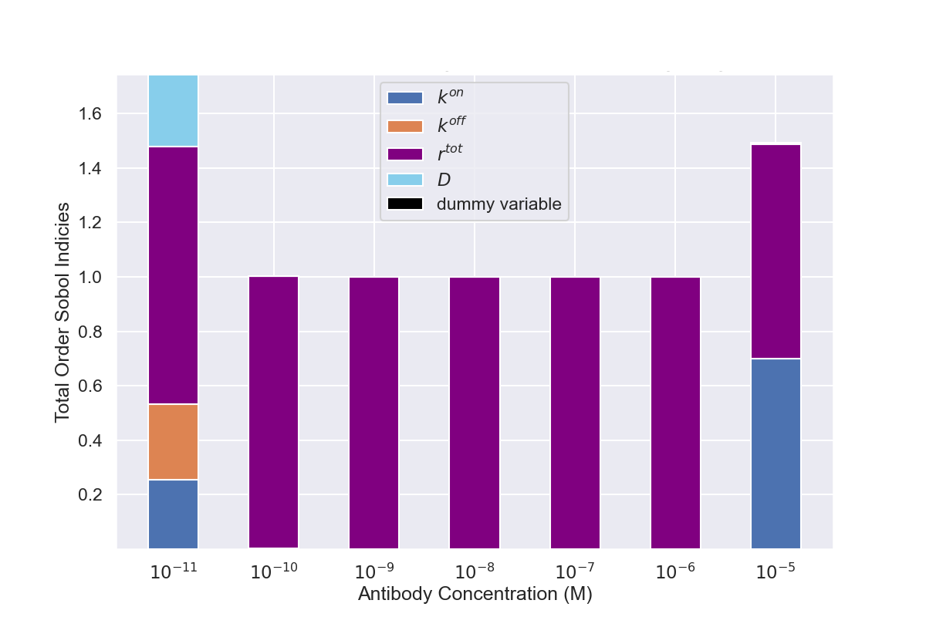
Sensitivity Analysis

Slide 11



The Ratio of Antibody to Receptor Affects Binding States

Slide 12
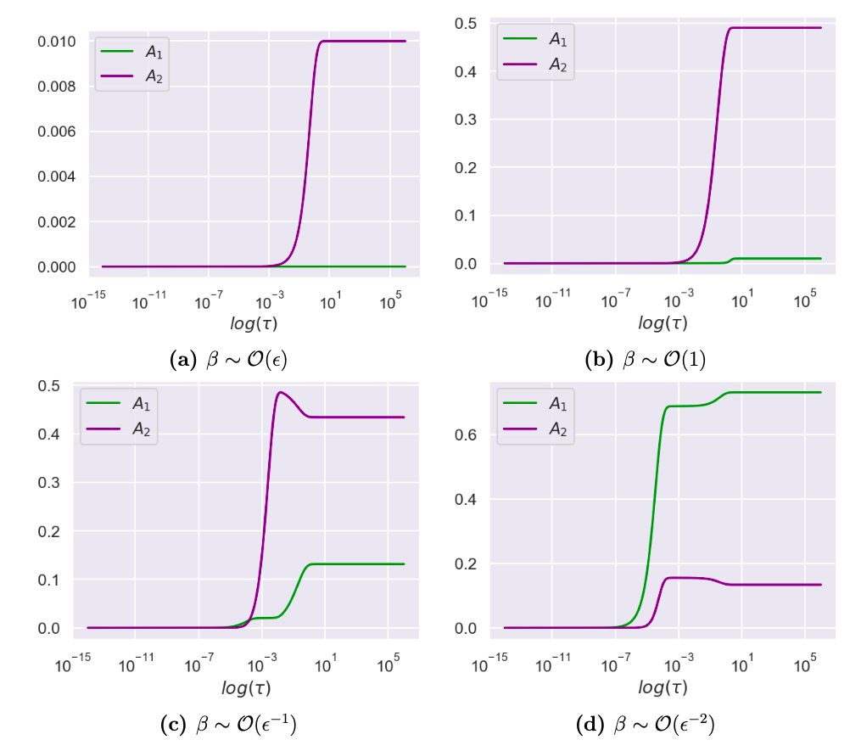
Model Dynamics

Slide 13
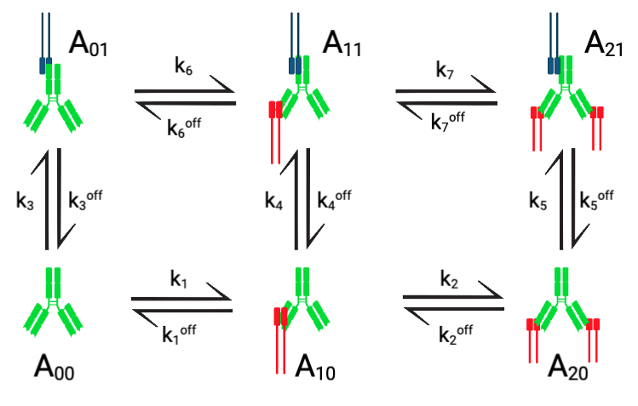
Synapse Model Schematic

Slide 14
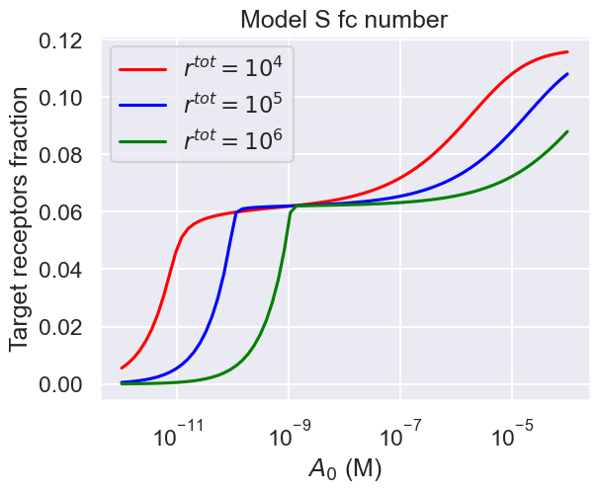
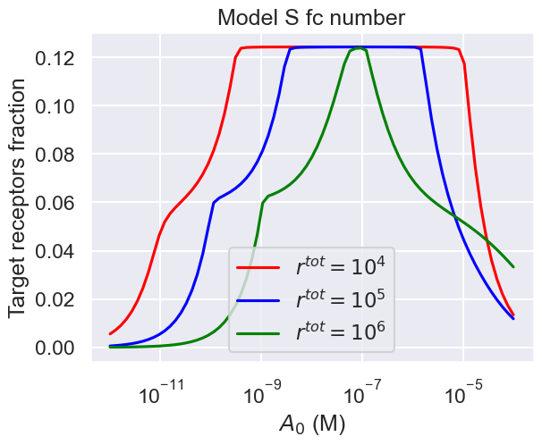
Prozone Effect Investigation

Slide 15
Conclusions from Work So Far
Little difference between models S and R
The ratio of antibody to receptor is an important parameter affecting steady states and dynamics
Synapse model suggests Fc receptor clogging contributes to prozone effect

Slide 16
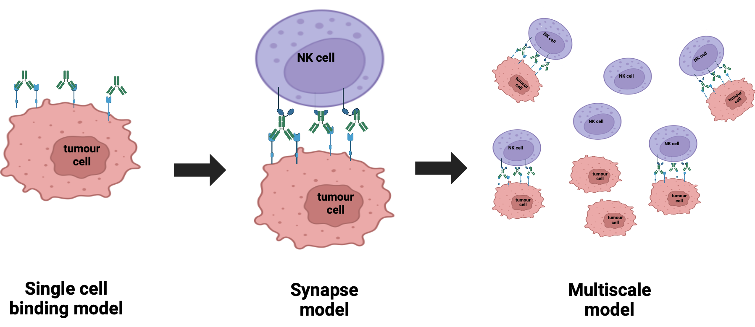
Thesis Outline
Chapter 1: A modelling investigation of antibody-target binding and interactions
Chapter 2: Using mathematical models to improve target cell selectivity of bispecific antibodies
Chapter 3: Multiscale modelling of ADCC
Chapter 4: A QSP model to study ADCC potency in vivo

Slide 17
Thank you for listening

